Slide 1
RollingMeadows.info
Sensors and Cognition
DWJ 4/15/2014 r2

Slide 2



Internet of Things
Sensors are cheap and innovative
Processors are cheap and powerful
Networking is smaller and faster
What is the next platform?

Slide 3
Context Awareness
Help the tools know what you want and provide it automatically, in context
Build a personal context sphere, not a simple portal to specific information
  Any tool can access the context to guide its operation
  Gestural interface, except that “gestures” include any aspect of the environment or history

Slide 4

Proof of Concept – Today's Design
Presentation Layer
Cognition Layer
Sense Layer
browser
browser
integrator
sensor
Sensor driver
view-gen
sensor
Sensor driver
integrator
Message broker
MQTT messaging protocol
Sensor driver
integrator
sensor
MQTT messaging protocol

Slide 5
Proof of Concept – Today's Design
Presentation Layer
Cognition Layer
Sense Layer
browser
browser
integrator
sensor
Sensor driver
view-gen
sensor
Sensor driver
integrator
Message broker
MQTT messaging protocol
Sensor driver
integrator
sensor
R1 – Mar 23 2014
MQTT messaging protocol

Slide 6
Proof of Concept – Today's Implementation
Logical Layer
Presentation Layer
Cognition Layer
Sense Layer
browser
gps
browser
integrator
NMEA/serial
gpsd
gpsd json/socket
view-gen
gpsMQTT.js
accel & mag
MQTT/socket
dapMQTT.cpp
registers/I²C
integrator
Mosquitto
Message broker
MQTT/socket
Sensor driver
integrator
sensor
Host System
Mobile or desktop
Spark - beaglebone
Shadow - beaglebone
R1 – Mar 23 2014

Slide 7
Proof of Concept – Today's Implementation
Logical Layer
Presentation Layer
Cognition Layer
Sense Layer
browser
gps
integrator
NMEA/serial
browser
gpsd
http/socket
gpsd json/socket
Private webserver
view-gen
MQTT/websocket
gpsMQTT.js
accel & mag
http/socket
registers/I²C
MQTT/socket
dapMQTT.cpp
Public webserver
view-gen
integrator
Private MQTT
Message broker
MQTT/socket
MQTT/socket
MQTT/websocket
integrator
Sensor driver
Public MQTT
Message broker
MQTT/socket
sensor
http://rollingmeadows.info
Host System
Public servers
Spark - beaglebone
Shadow - beaglebone
R2 - Apr 15 2014

Slide 8
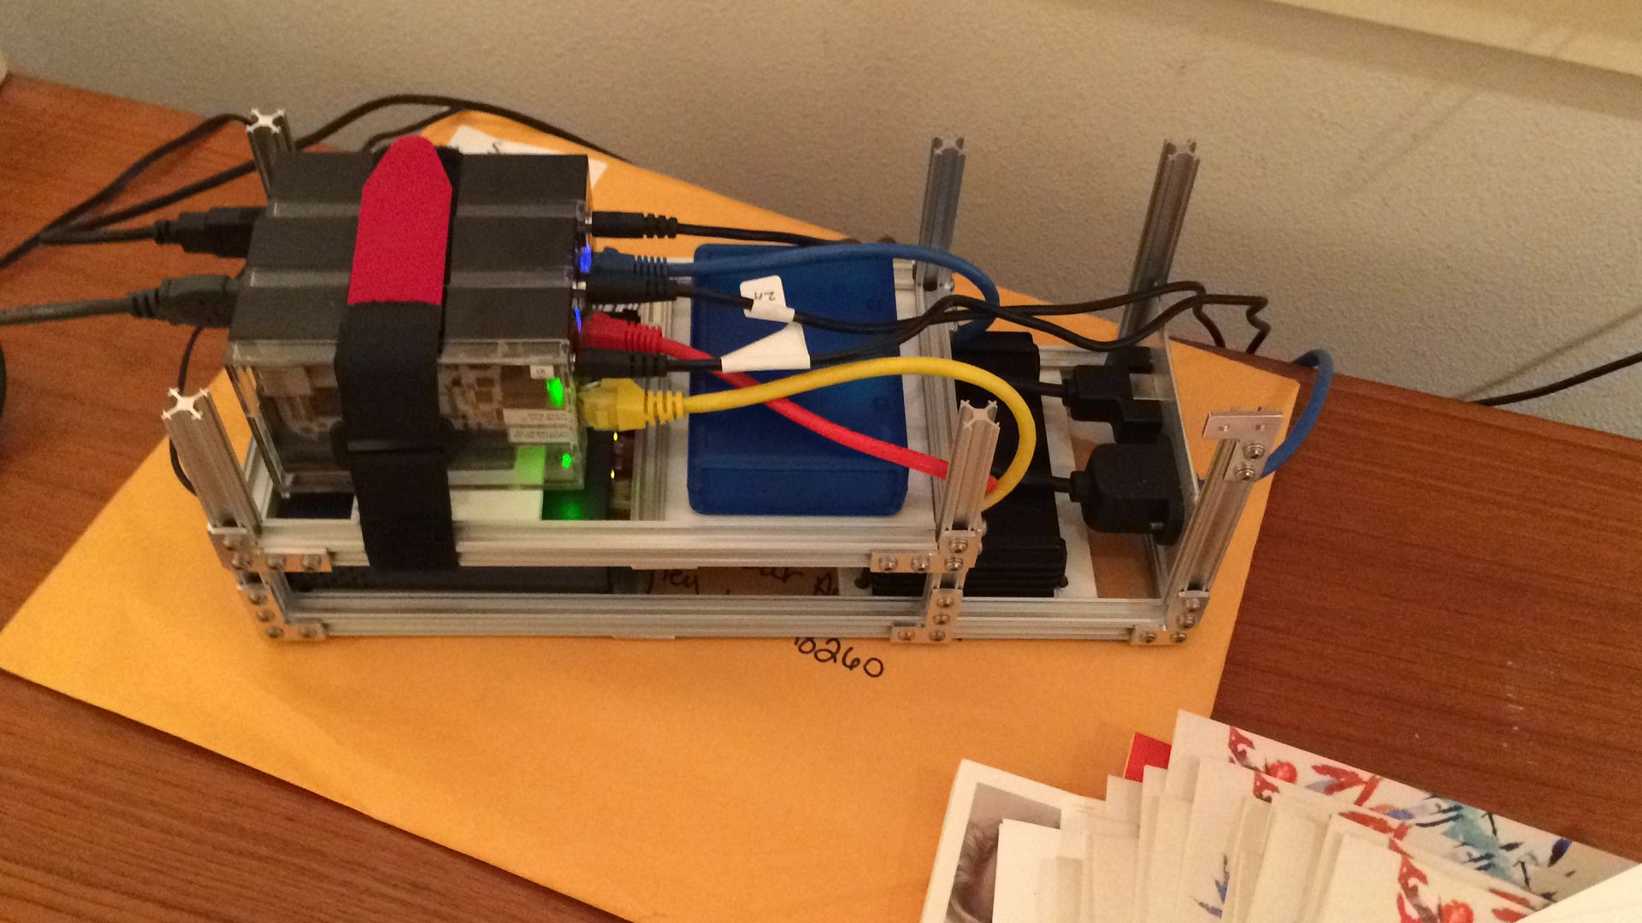
Roller LRU – Blue Label WIP

Slide 9
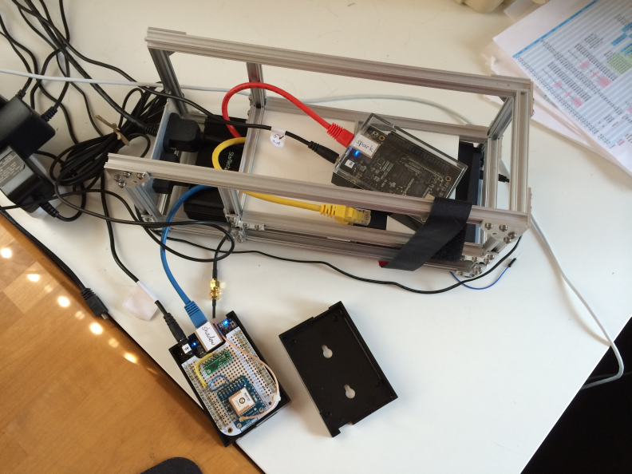
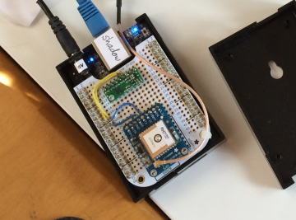
Roller LRU – Blue Label WIP
4/15/2014

